Slide 1
Integrating Public Policy into Markets
Vincent P. Duane
PJM
Sr. VP Law, Compliance & External Relations
June 2, 2017

Slide 2
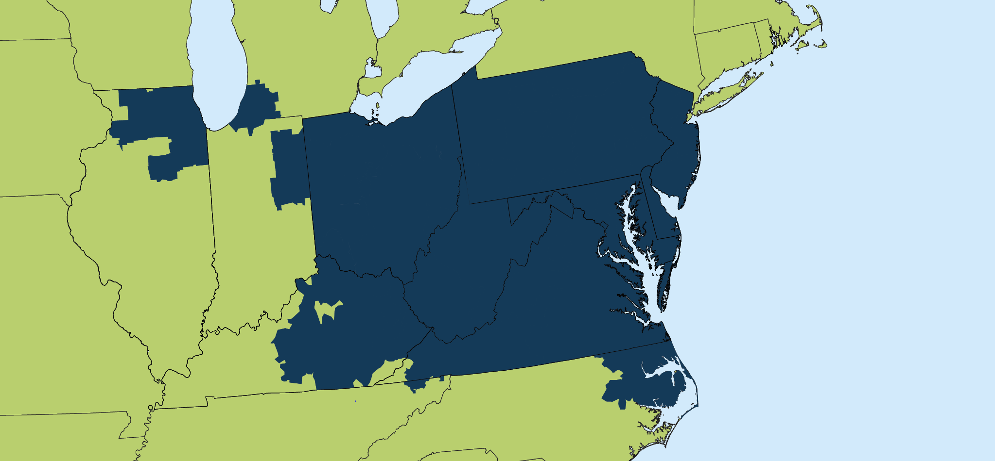
State / Federal Policies
Harrisburg, PA
Trenton, NJ
Columbus, OH
Springfield, IL

Slide 3
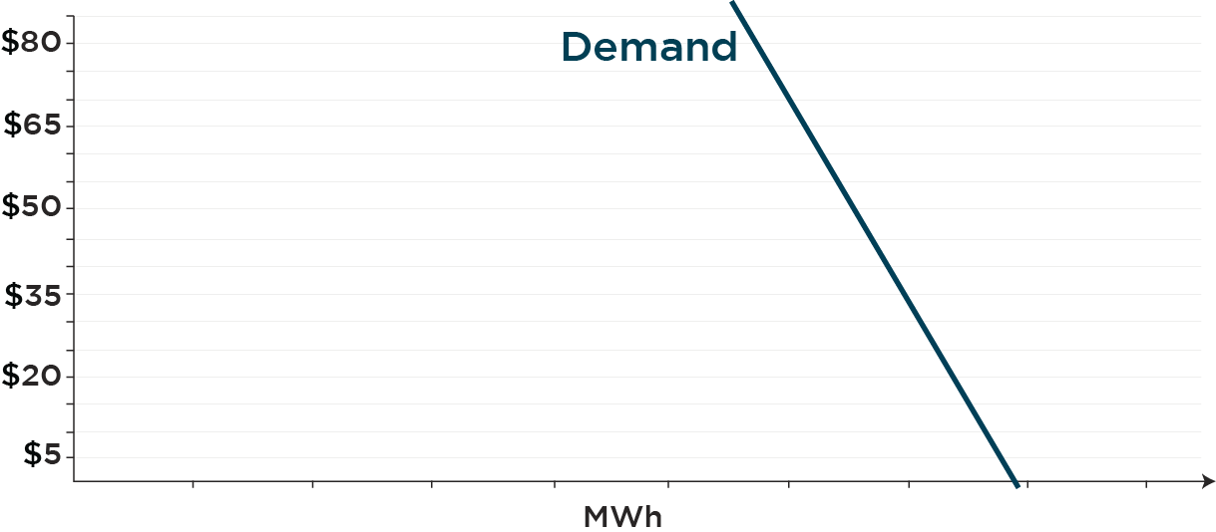
Energy Price Example
Locational Marginal Price

Slide 4
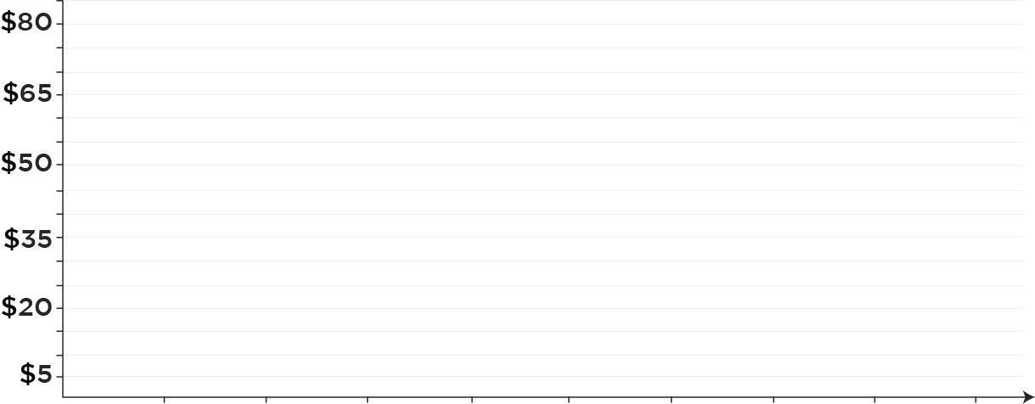
Capacity Market Example
Cleared Capacity
Cleared Capacity
Supply Offers
MW

Slide 5
FERC May 1,2 Technical Conference

Slide 6
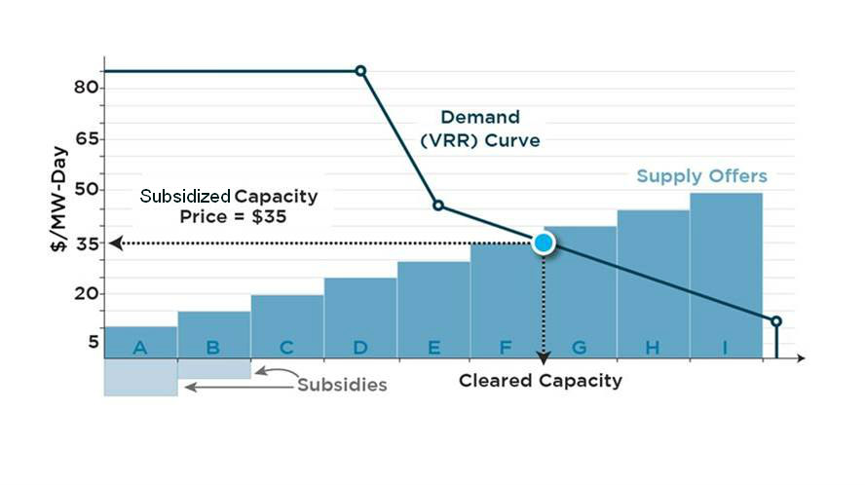
First Stage of Auction; Cleared Capacity Determined
{corrected}
Notes:
Two stage clearing process.

Slide 7
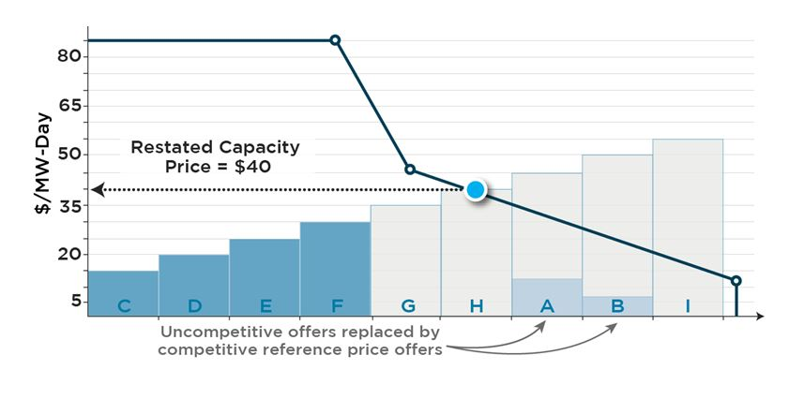
Capacity Repricing: Second Stage; Price Determined
Notes:
A redetermination of the price.
This ensures that the cleared resources get a just and reasonable price.
However, the losers are G & H who don’t clear because of the subsidized units.

Slide 8
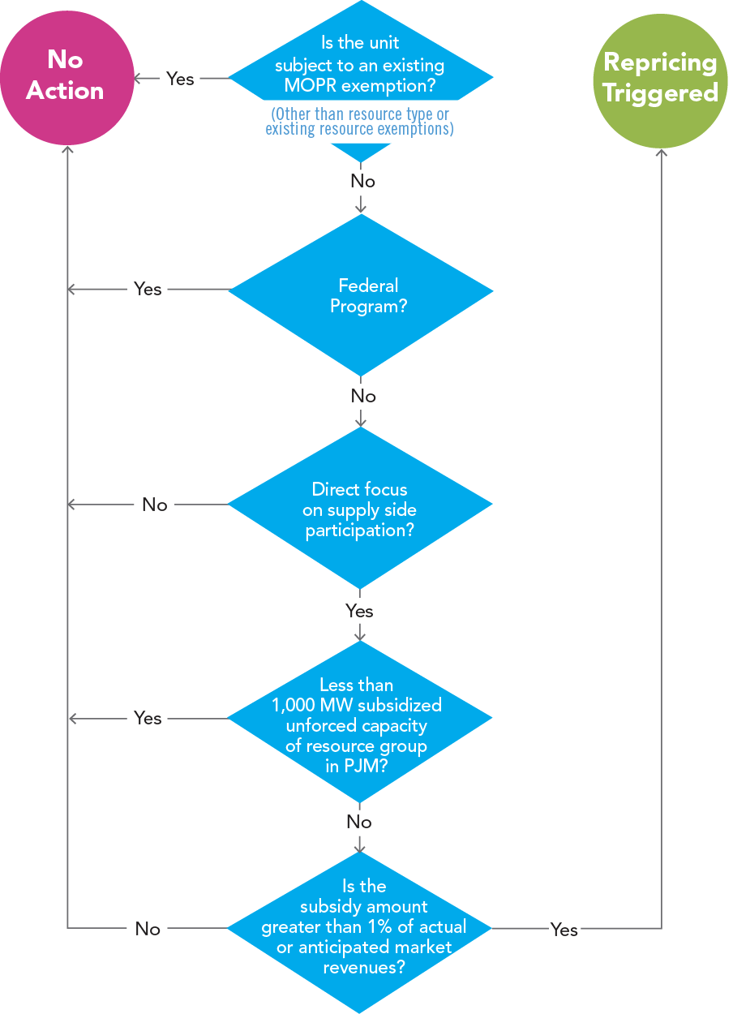
Identifying Subsidies that Trigger “Re-Pricing”
For more details, see
PJM’s Capacity Market Repricing Proposal

Slide 9
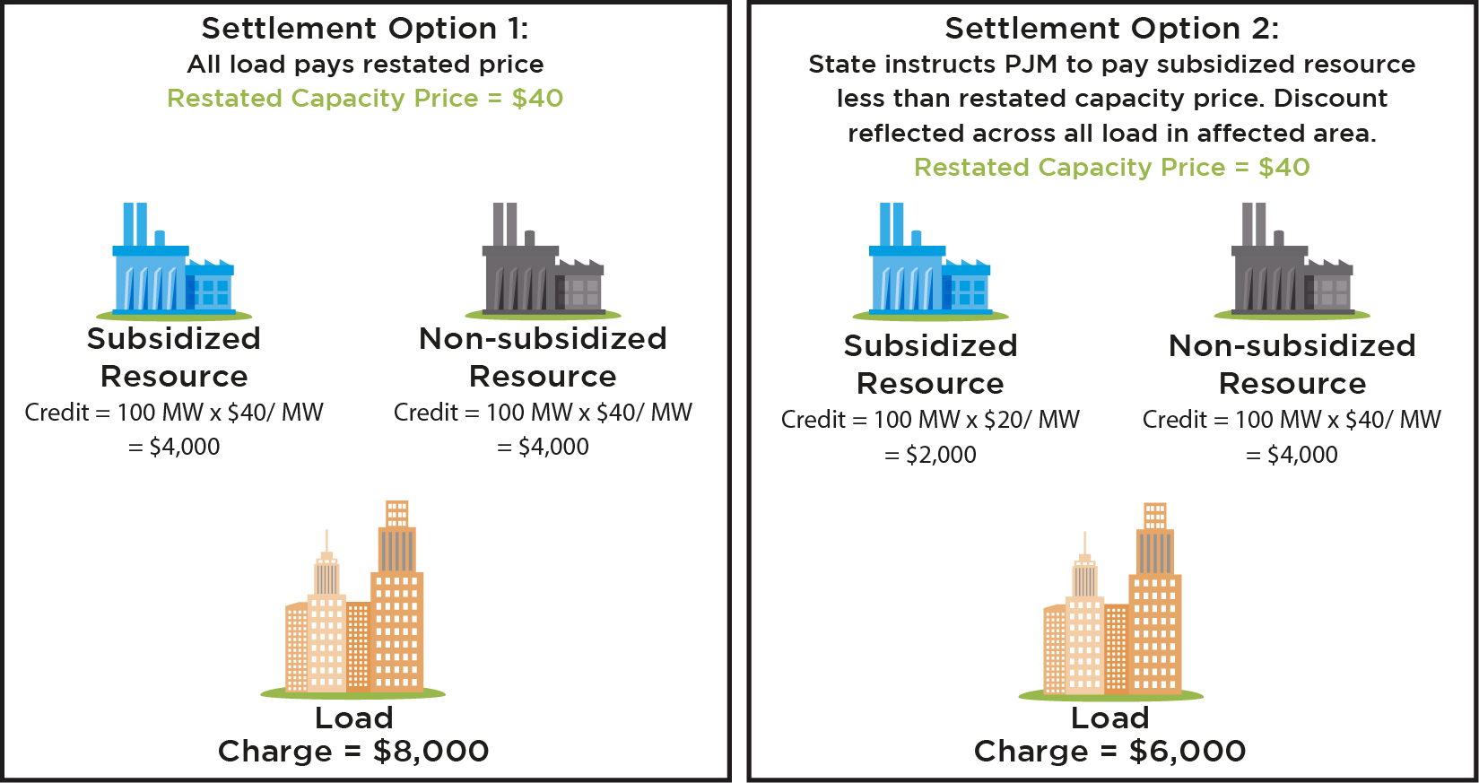
Capacity Market Repricing - Settlement

Slide 10
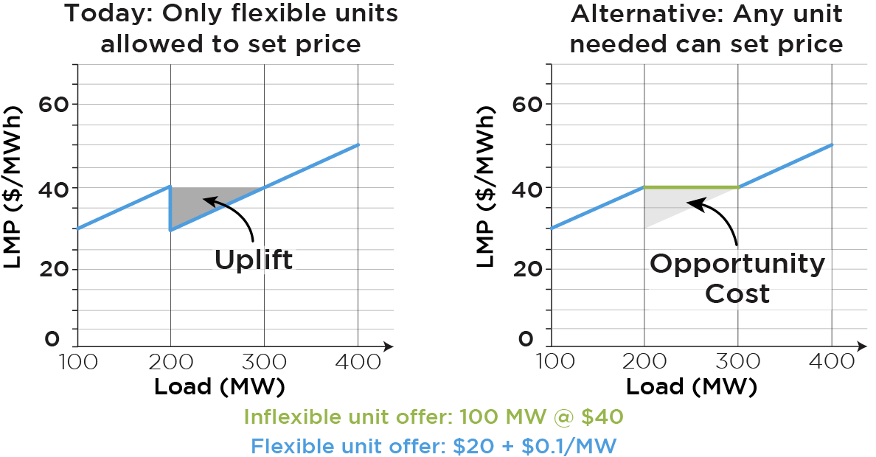
Price Formation In The Energy Market

